Slide 1
Adaptive Responses of Natural Killer Cells Exhibit Distinct Requirements Among Members of the Ly49 Receptor Family
Gayani S Gamage¹, Daniel Medina-Luna¹, Michal Scur¹, Hagaag S Zein¹, Mir Munir A. Rahim² Brendon D Parsons¹,Andrew P Makrigiannis¹ ¹Department of Microbiology and Immunology, Faculty of Medicine, Dalhousie University,5850 College Street, Halifax, B3H 4H7,NS, Canada. ²Biological Sciences Department, University of Windsor, 450 Patricia Road, Windsor, N9B 3B9, ON, Canada
Notes:
.

Slide 2
Introduction
Natural Killer (NK) Cell
Innate lymphocytes that can rapidly mediate cytotoxicity and secrete cytokines when activated by infected, transformed or “stressed” cells
Ly49 Receptors
MHC class-I specific receptors
Highly polygenic & polymorphic receptor family
Key regulators in NK cell functions & NK cell education
New Facet of NK cells: NK Cell Memory
Immune memory is a hallmark of adaptive T & B cells
Memory cells are
-long-lived
-antigen-specific
-respond rapidly & robustly
NK cells display characteristics of memory cells
Ly49C/I are important for NK cell memory
Main Research Question
Are Ly49 receptor-mediated NK memory responses restricted to Ly49C and/or Ly49I or can other receptors of the Ly49 family contribute to the formation of NK memory?

Slide 3
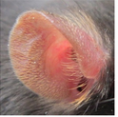
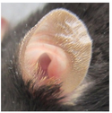
Methods- Mouse Ear Swelling Assay
Research question: What is the role of Ly49G receptors in mediating NK cell memory responses?
Sensitization Phase
Rest Phase
Challenge Phase
Measure Ear Swelling
Haptens
Cutaneous
D0 and D1
Challenge Ear
Antigen in vehicle
Control Ear
Vehicle alone
4 or 11 days as indicated in each graph
Peptides
Hock Inj.
D0 and D7
_
=
challenge
ear
thickness
control
ear
thickness
Ear
swelling
Mouse Strains:
-Rag^{KO} H-2^{d}
-Rag ^{KO} Ly49G ^{KO} H-2^{d}K cells expressing Ly49G receptors do
Expected results:
If Ly49G mediates NK cell memory responses:
- Ear swelling in Rag ^{KO} H-2^{d}
- No ear swelling in Rag ^{KO} Ly49G ^{KO} H-2^{d}Ly49G receptors do

Slide 4
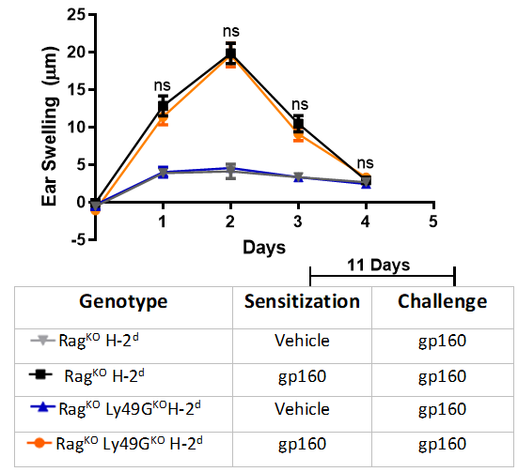
Ly49G receptors are not required to mediate DNFB or gp160- induced ear swelling response
A
DNFB-Induced Ear Swelling
Response
B
gp160-Induced Ear Swelling
Response
Ly49 WT
EAR SWELLING
(Memory Response)
DNFB/gp160
DNFB/gp160
Ly49G KO
EAR SWELLING
(Memory Response)
DNFB/gp160
DNFB/gp160
Figure 1. The mouse contact hypersensitive ear swelling assay was performed using chemical hapten DNFB (A) & peptide gp160 (B) in mice that lack T & B cells (Rag^{KO}), Ly49G receptors and Rag^{KO} mice that contain Ly49G receptor congenic for MHC-I H-2^{d} haplotype. Statistics were calculated using a two-way ANOVA followed by the Bonferroni post-hoc test. Significance is indicated with * p<0.05, ** p<0.01, *** p<0.001

Slide 5
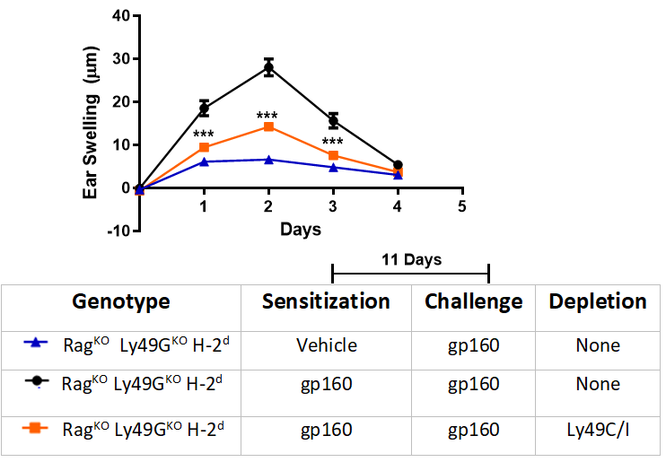
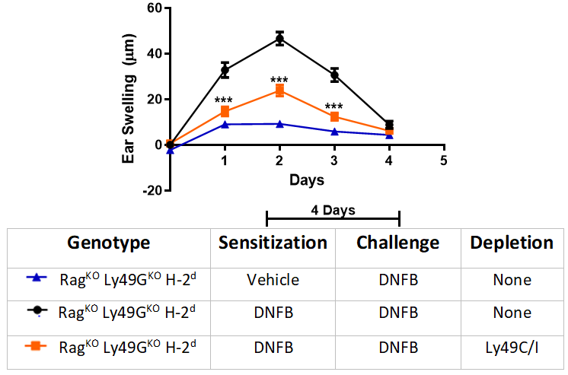
Depletion of NK cells expressing Ly49C/I significantly reduced the DNFB & gp160 -induced ear swelling response
A
DNFB-Induced Ear Swelling Response
B
gp160-Induced Ear Swelling Response
Ly49C/I WT
DNFB/gp160
DNFB/gp160
EAR SWELLING
Ly49C/I Depleted
SIGNIFICANT EAR SWELLING
REDUCTION
DNFB/gp160
DNFB/gp160
Figure 2. Representative plots of DNFB (A) & gp160 (B)-induced mouse ear swelling response in Rag^{KO} Ly49G^{KO}H-2^{d} mice that treated with depleting antibodies targeting Ly49C/I (5E6) and control (PBS). Statistics were calculated using a two-way ANOVA followed by the Bonferroni post-hoc test. Significance is indicated with * p<0.05, ** p<0.01, *** p<0.001

Slide 6
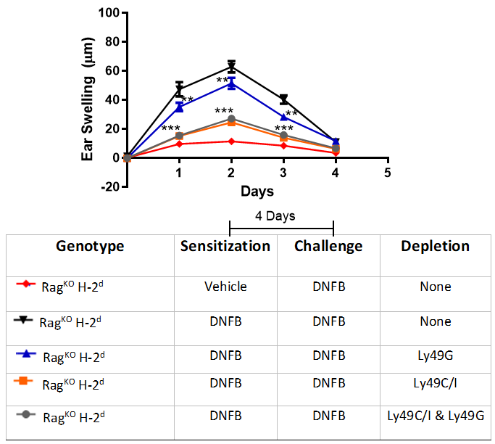
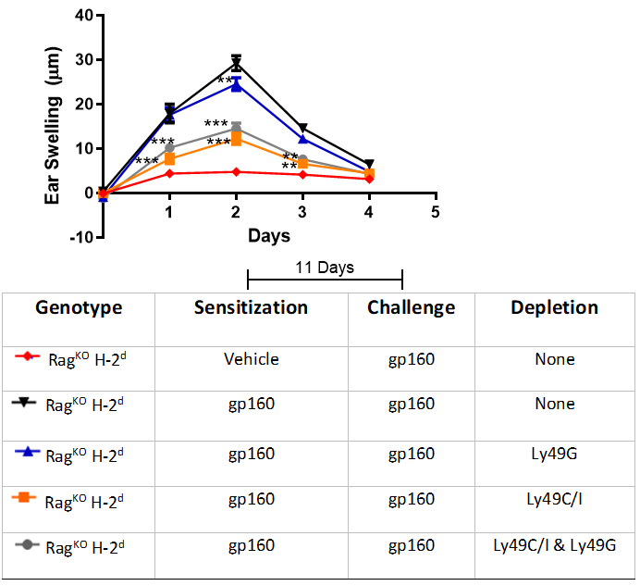
Depletion of NK cells expressing Ly49G receptors doesn’t affect the DNFB or gp160-induced ear swelling response
Ly49 WT
DNFB/gp160
DNFB/gp160
EAR SWELLING
A
DNFB-Induced Ear Swelling
Response
B
gp160-Induced Ear Swelling
Response
Ly49G Depleted
DNFB/gp160
DNFB/gp160
EAR SWELLING
Ly49C/I Depleted
SIGNIFICANT
EAR SWELLING
REDUCTION
DNFB/gp160
DNFB/gp160
Figure 3. Representative plots of DNFB (A) & gp160 (B)-induced mouse ear swelling response in Rag^{KO} H-2^{d}mice that treated with depleting antibodies targeting Ly49C/I (5E6), Ly49G (4D11) and control (PBS). Statistics were calculated using a two-way ANOVA followed by the Bonferroni post-hoc test. Significance is indicated with * p<0.05, ** p<0.01, *** p<0.001

Slide 7
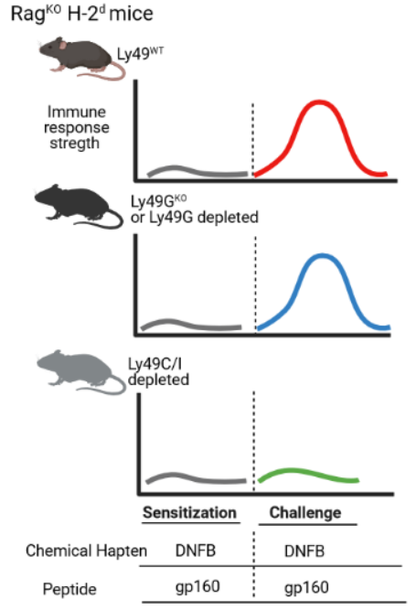
Conclusions & Future Directions
Acknowledgement
Conclusions
Conclusions
Supervisor
-Dr. Andrew Makrigiannis
Everyone in Mak lab
Supervisory Committee
Funding Partners
.
Future Directions
Determine the antigen-specificity of the Ly49 receptor-mediated NK cell memory
Characterize the phenotypical features of the adaptive innate memory cells
Analyze the pathway of the Ly49 receptor-mediated NK cell memory
Created with BioRender.com

